Slide 1

Diabetic Retinopathy Detection
BY: AYUSHI BHATLA

Slide 2
INTRODUCTION

Slide 3
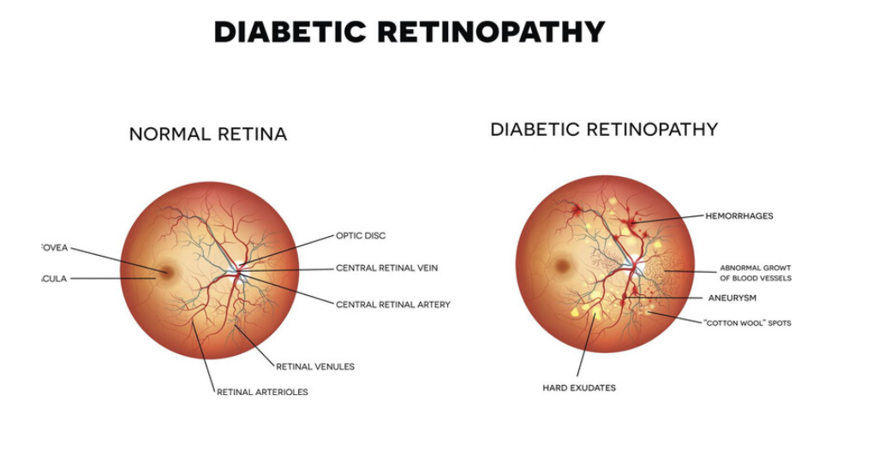
Diabetic Retinopathy
Diabetic Retinopathy (DR) is a diabetes complication that affects the eyes. It occurs when high blood sugar levels damage the tiny blood vessels in the retina — the light-sensitive tissue at the back of the eye.
As the condition progresses, it can lead to:
Leakage of blood or fluid into the retina
Swelling in parts of the retina (like the macula)
Abnormal blood vessel growth
Eventually, vision loss or complete blindness

Slide 4
PROBLEM STATEMENT
Rising Case of Diabetic Retinopathy:
DR affects over 93 million people globally
Often asymptomatic in early stages, making early detection crucial
Leading cause of vision impairment and blindness in working-age adults.
Challenges in Manual Diagnosis:
Required trained ophthalmologist
Time consuming and subjective
If resource-limited settings, many patients go undiagnosed.
Role of Deep Learning:
Automates detection with high accuracy
Can screen large volumes of retinal images
Offers potential for early diagnosis and cost-effective solutions

Slide 5
Literature Review
1. Deep Learning Advancements in DR Detection
Recent studies have explored various deep learning architectures for DR detection, including CNNs, Inception-V3, and Inception-V4 networks. These models have been trained on large datasets like EyePACS and MESSIDOR, achieving high accuracy and sensitivity in identifying DR stages .​PMC
2. Computational Efficiency and Model Optimization
Research has focused on developing computationally efficient deep learning models for real-time DR detection. Incorporating vision transformers into these models has shown significant improvements in accuracy while maintaining efficiency .​SpringerLink
3. Challenges in DR Detection
Despite advancements, challenges persist, such as computational complexity, class imbalance leading to low accuracy in DR stage detection, and high maintenance costs. Addressing these issues is crucial for the practical implementation of AI models in clinical settings .​ScienceDirect
4. Explainability in AI Models
The integration of explainable AI techniques, like Grad-CAM, has been emphasized to enhance the interpretability of deep learning models. This approach aids clinicians in understanding model decisions, thereby increasing trust and facilitating adoption in medical practice .​

Slide 6
Objective
To build and train deep learning models for accurate classification of Diabetic Retinopathy stages using retinal fundus images.
To compare the performance of various CNN architectures (e.g., VGG16, ResNet50, EfficientNet) based on accuracy, F1-score, and Accuracy.
To evaluate the models' effectiveness in early detection of Diabetic Retinopathy to support clinical diagnosis and reduce the risk of vision loss.

Slide 7
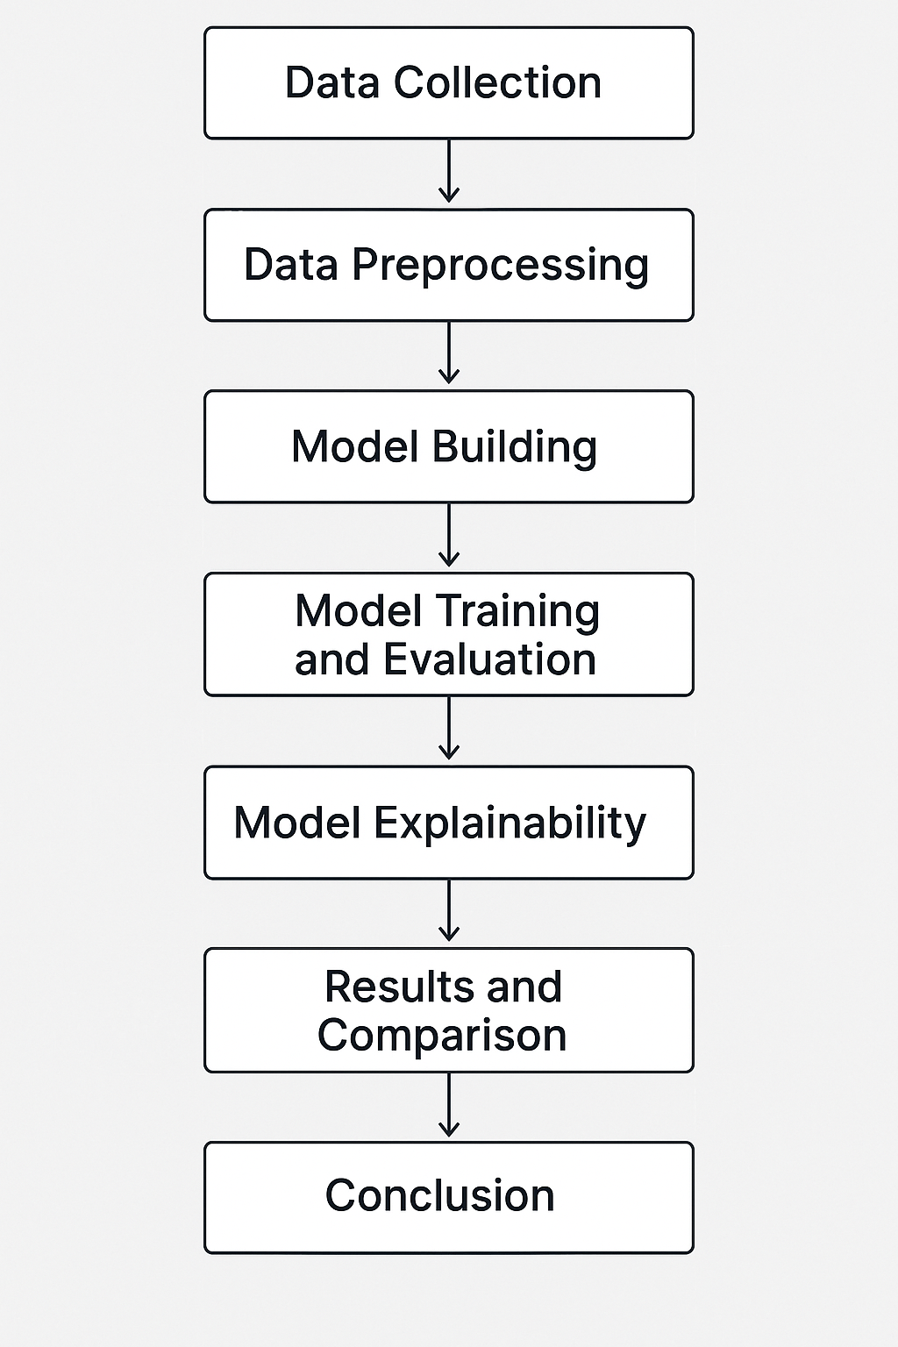
Project Workflow
1. Data Collection
2. Data Preprocessing
3. Model Building
4. Model Training and Evaluation
5. Model Explainability
6. Results and Comparison
7. Conclusion

Slide 8
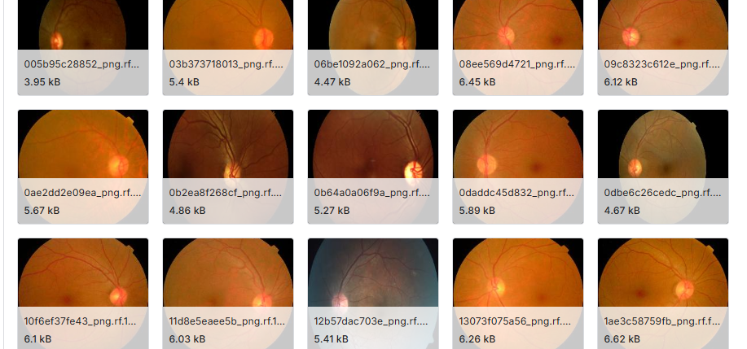
About Dataset
Source: • Kaggle: Diabetic Retinopathy Detection Dataset • Link: https://www.kaggle.com/competitions/diabetic-retinopathy-detection
Structure:
• Three folders: train, validation, test • Two classes: – dr (diabetic retinopathy present) – no_dr (no diabetic retinopathy)
Image Count:
• Train: [2076] images • Validation: [531] images • Test: [231] images • Total: [2838] images
Image Format & Size: • Format: JPEG/PNG • Resized to 224×224 pixels for model compatibility
Preprocessing:
• Rescaling pixel values to [0, 1] • Augmentation: rotation, zoom, flip for generalization

Slide 9
Implementation Models
In this project, we explored and trained a diverse set of deep learning models to classify retinal images into Diabetic Retinopathy (DR) and No_DR:
1. CNN (Convolutional Neural Network):
Custom-built 2-layer CNN architecture
Used as a baseline for image classification
2. RNN (Recurrent Neural Network):
Combined CNN features with LSTM using Time Distributed wrapper
Useful for capturing sequential spatial features (simulated 1-frame sequences)
3. DNN (Deep Neural Network):
Fully connected architecture
Used flattened image input for classification
4. VGG16 (Transfer Learning):
Pre-trained VGG16 (ImageNet) as feature extractor.
Added custom dense layers for DR classification

Slide 10
Implementation Models
In this project, we explored and trained a diverse set of deep learning models to classify retinal images into Diabetic Retinopathy (DR) and No_DR:
5. RESNET 50 (Transfer Learning):
Utilized deep residual learning via ResNet50
Fine-tuned top layers with additional dense layers
6. LeNet (Recurrent Neural Network):
Classic 1998 LeNet-5 architecture adapted to RGB and modern input size. Used as a lightweight comparative model
7. AlexNet (Recurrent Neural Network):
Classic 1998 LeNet-5 architecture adapted to RGB and modern input size. Used as a lightweight comparative model

Slide 11
Optimizers Used
Adam (Adaptive Moment Estimation)
Combines momentum and adaptive learning rates.
Fast convergence with good generalization.
Learning Rates Used: 0.001, 0.01
SGD (Stochastic Gradient Descent)
Classical optimizer with momentum.
Slower convergence but often leads to better minima.
Learning Rates Used: 0.001, 0.01
RMS prop
Maintains a moving average of squared gradients.
Works well with non-stationary objectives.
Learning Rates Used: 0.001, 0.01

Slide 12
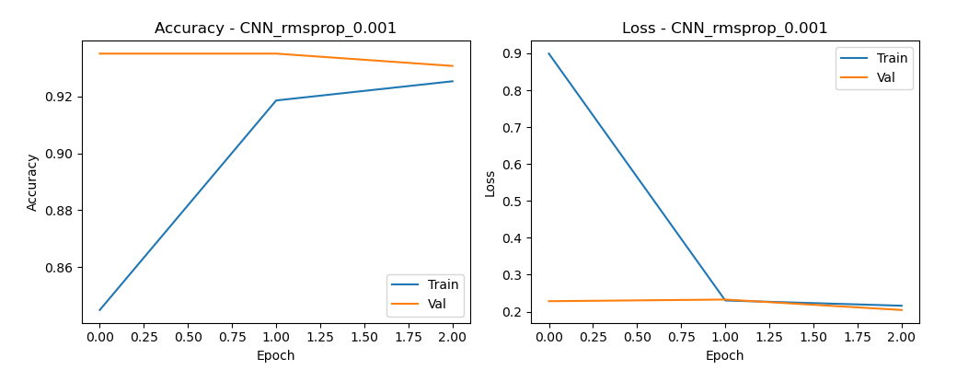
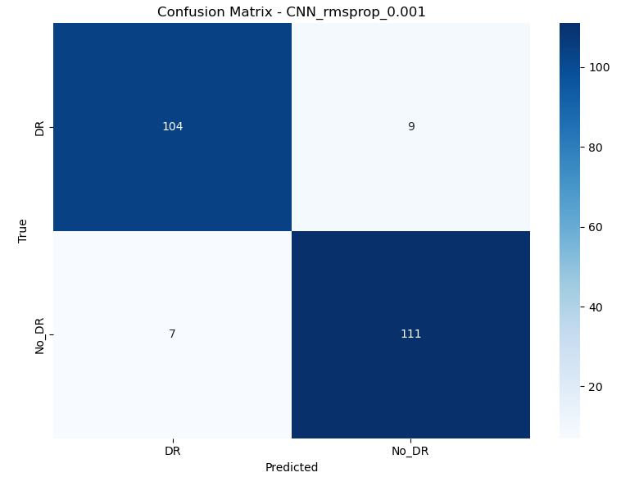
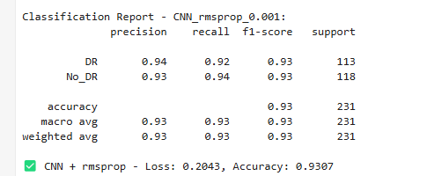
CNN Model Results [rmsprop_0.001]

Slide 13
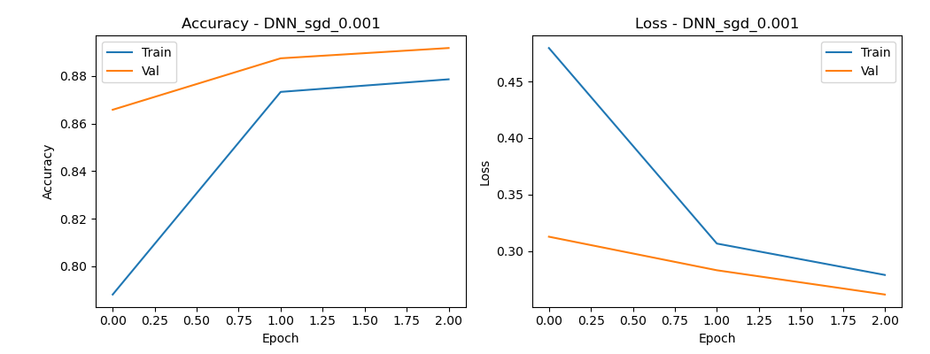
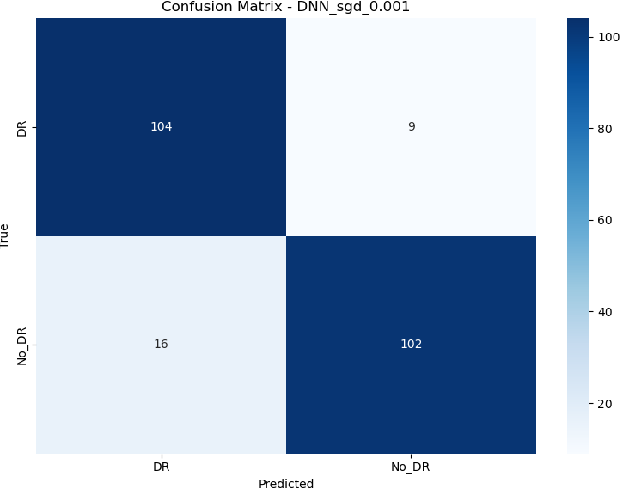
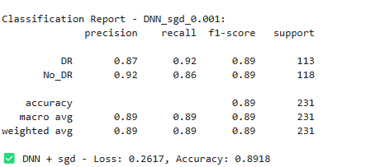
DNN Model Results [sgd_0.001]

Slide 14
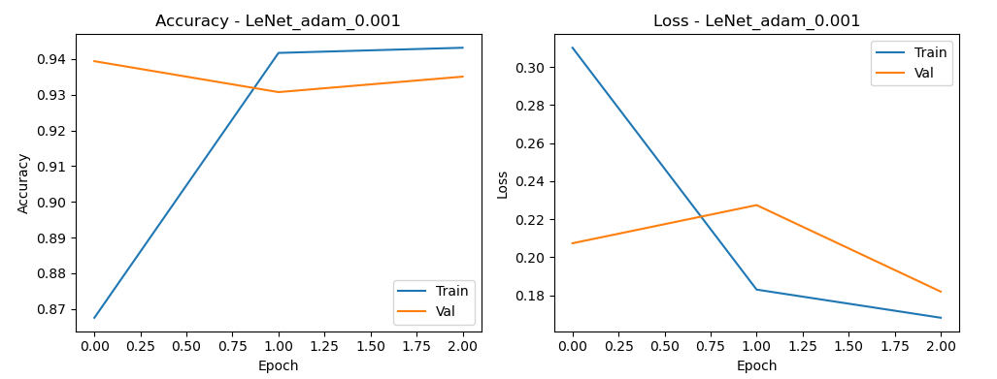

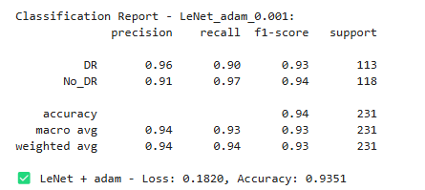
LeNet Model Results [adam_0.001]

Slide 15
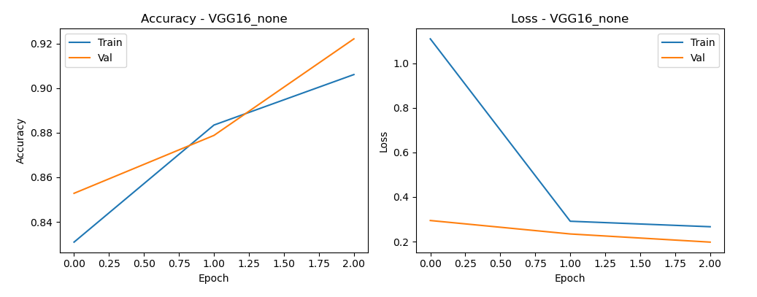
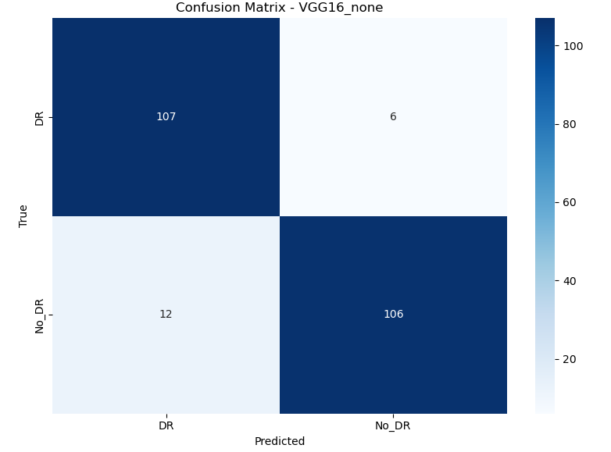
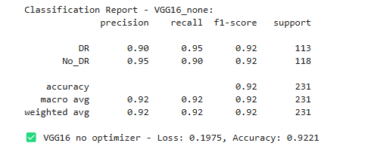
VGG16 Model Results [None]

Slide 16
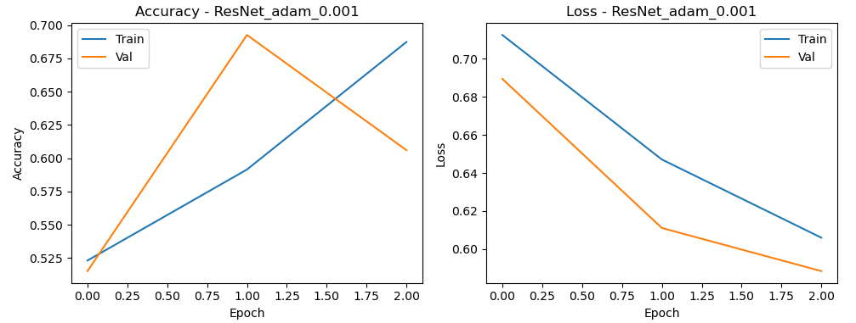
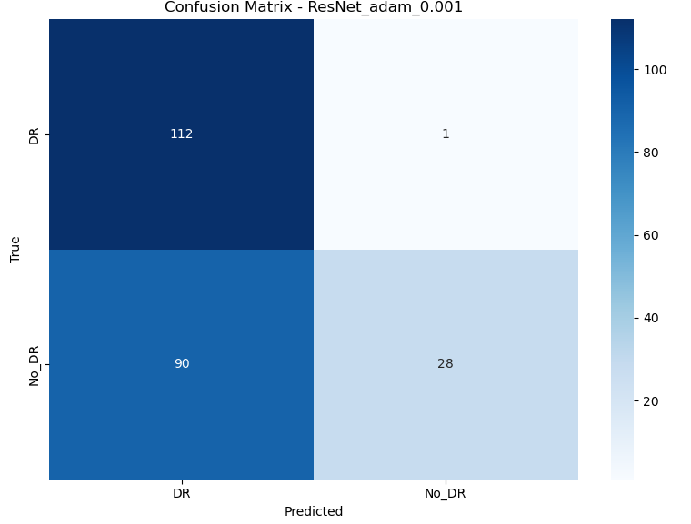
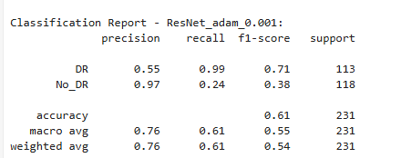
ResNet Model Results [adam_0.001]

Slide 17
Comparative Analysis
Rank | Model | Optimizer | LR | Accuracy | Loss
1 | VGG16 | adam | 0.001 | 95.24% | 0.1697
2 | LeNet | adam | 0.001 | 93.51% | 0.1820
3 | CNN | rmsprop | 0.001 | 93.07% | 0.2043
4 | CNN | adam | 0.001 | 92.64% | 0.2087
5 | VGG16 | sgd | 0.001 | 92.21% | 0.2525
6 | DNN | adam | 0.001 | 88.31% | 0.2519
7 | ResNet | adam | 0.001 | 60.61% | 0.5884

Slide 18
Conclusion
Best Performing Model • VGG16 with Adam optimizer (learning rate = 0.001) • Accuracy: 95.24% • Loss: 0.1697 • Delivered the most consistent and high-performing results
Optimizer and Learning Rate Insights • Adam optimizer outperformed others across CNN, LeNet, DNN, and VGG16 • Higher learning rates (0.01) generally led to a decline in accuracy • RMSprop showed average performance but lacked consistency • SGD performed less effectively, especially with complex models
Model Architecture Observations • Simpler architectures like CNN and LeNet performed well when tuned • DNN achieved moderate performance but showed instability • ResNet underperformed—likely due to dataset size, overfitting, or configuration complexity

Slide 19
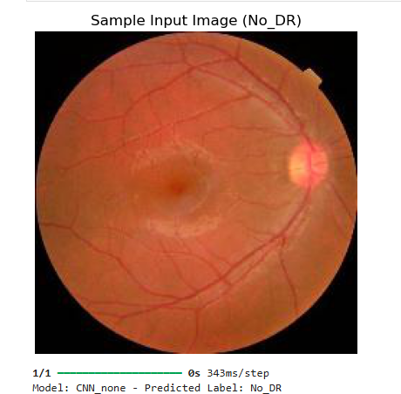
Conclusion
4. Deployment Readiness:
• VGG16 with Adam (0.001) is the most suitable for deployment
• Combines high accuracy, low loss, and stable learning behavior
• Well-suited for real-world diabetic retinopathy screening applications
5. Final Recommendations
• Prioritize VGG16 with Adam (0.001) for production
• Perform careful hyperparameter tuning (especially optimizer and learning rate)
• Ensure proper preprocessing, regularization, and data augmentation• Validate on external/clinical datasets before final deployment

Slide 20
Future Work
Expand Dataset
Include more diverse and clinically verified retinal images
Address class imbalance and edge cases
Model Optimization
Explore ensemble models (e.g., CNN + VGG16)
Apply advanced tuning techniques (Bayesian Optimization, AutoML)
Explainability
Integrate Grad-CAM and SHAP for visual model interpretation
Improve model transparency for medical decision support
Real-World Testing
Validate model performance on external hospital datasets
Deploy in clinical settings and gather user feedback
Mobile and Web Deployment
Develop lightweight, optimized versions for on-device inference
Build user-friendly interfaces for medical practitioners

Slide 21
Thank You

